Slide 1
Liste des participants
AFNOR
Wavestone
AGC Plasma Technology Solutions
CENAERO
GDTech
ChemLabServices
CRM Group
MITIS
UTAC
Saint-Gobain
Touch Sensity
HYCCO
Institut de la Corrosion
TEMISTh
Régions Ile de France/Normandie

Slide 2
AFNOR

Slide 3
Alexandre COLOMBIER
+33 7 72 20 26 47 – alexandre.colombier@afnor.org
AFNOR, French National Standardization Body - NGO
Innovation and Development for Standardization in the Field of Energy Production and Efficiency
More information on https://normalisation.afnor.org/ and https://www.hsbooster.eu/

Slide 4
Unlocking the Potential: Practical Gains Standardization
Enhanced safety measures and risk mitigation through standardized protocols in hydrogen production, storage, and transportation.
Increased interoperability and market acceptance by adhering to common standards, promoting a more robust hydrogen ecosystem.
Accelerated time-to-market for hydrogen technologies due to reduced barriers and streamlined regulatory compliance.
Innovation towards the market: Setting the frame
Include standardization in your Horizon Europe call and benefit from the platform call “CEN Workshop Agreement” to define the outlines of the future standards based on the solution you have developed through research projects or innovation
More information on : https://www.hsbooster.eu/

Slide 5
How can we help you?
AFNOR relies on a community of 25000+ technical experts on many fields, we can help in reaching out for potential partners in a consortium. More over, AFNOR is part of a global European network and can reach experts all over Europe
AFNOR has the ability to do bibliographical mapping on the technical state of the art (standards, best practices) to serve as a basis of work as well as a support for
AFNOR is link with the national PI organization, to provide a 360° support on innovation
AFNOR has the platform to build technical standards in Europe to ease the transition from a R&D project towards industrialization and market adoption
AFNOR is expert in project management and consensus-based animation facilitating group work
AFNOR will guide in drafting and follow-up of the Horizon Europe Standardization Questionnaire

Slide 6
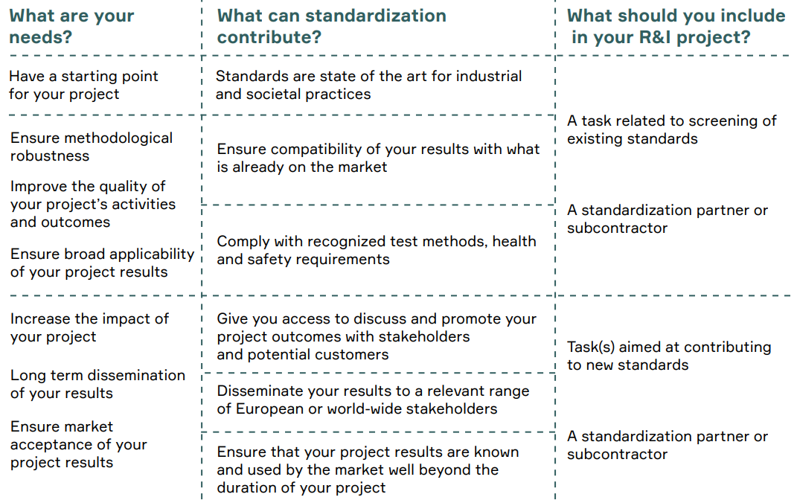
In practice
HORIZON-CL5-2023-D1-01-03: Climate impacts of a hydrogen economy
A rigorous assessment of the behaviour of hydrogen in the oxidizing cycles of the atmosphere related to methane, water vapour, carbon monoxide and ozone.
A rigorous assessment of the ways in which large-scale production, distribution and use of hydrogen (e.g. as an energy carrier or industrial feedstock) can affect anthropogenic radiative forcing.
Better monitoring tools (methodologies and instruments) for detecting and quantifying hydrogen leakage (in situ or through remote sensing).
CEN-CENELEC GUIDE 39

Slide 7
Wavestone

Slide 8
Wavestone works with it’s clients on large transformation programs as well as innovation financing & Management
Mathias Kechemair- Consultant Energy & Innovation Financing - Wavestone MNU
Wavestone: Consulting Company
Manufacturing Energy & Utilities Practice
Within this practice, Wavestone addresses all the challenges of the actors of those sectors on management & Strategy.
A dedicated team has experience and expertise working with multi-sectorial consortia for funding through public Grants both national and international. We have experience in supporting actors in their applications, negotiation with the institutions as well as project management and monitoring of funded projects.
Feel free to reach out !
Mathias kechemair: mathias.kechemair@wavestone.com +33638742166
Wavestone: Discover the Positive Way

Slide 9
Overview of Wavestone MNU Activities
Industrial Value Chain
Management of research & Innovation
Digitalization & Performance of Engineering
Operational Excellence
Supply Chain
Sales & Customer experience
Business Functions
Finance & Procurement Transformation
Innovation Financing
Sustainable Industries
IT & IS roles
Data and process digitalization
IS Architecture & transformation
Transformation Management & Assistance
Change Management
Large Project management

Slide 10
AGC Plasma Technology Solutions

Slide 11
AGC Plasma Technology Solutions
Offering innovative and clean solutions to deposit functional nano-layers on a variety of substrates by leveraging our experience in thin film coating technologies.
Jeroen Schotsaert Jeroen.schotsaert@agc.com
+32 499 99 30 09
www.agc-plasma.com
A business unit within AGC Glass Europe SA (Industry)
WWW.AGC-PLASMA.COM

Slide 12
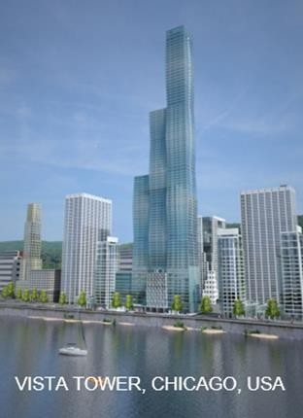
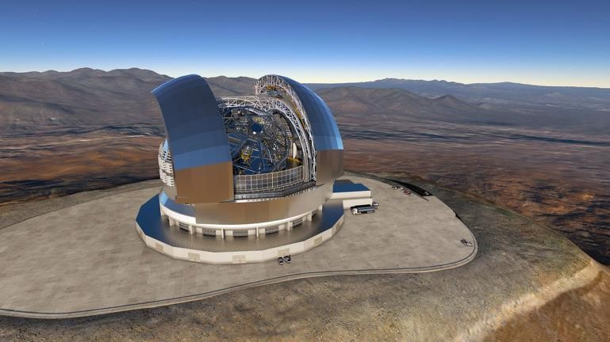
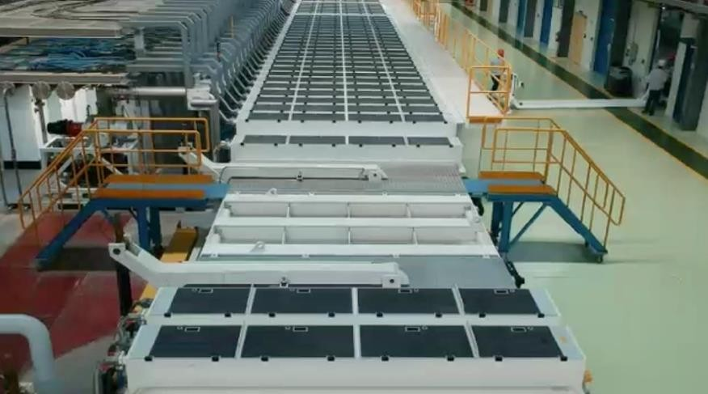
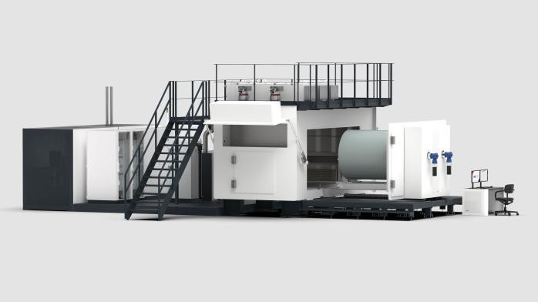
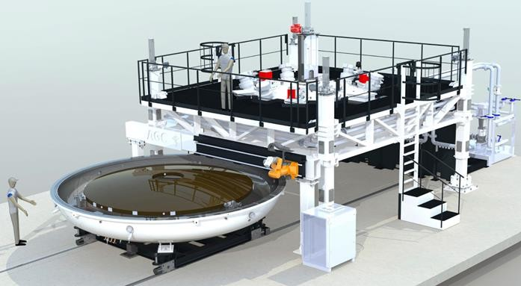
Supplier of industrial vacuum coating equipment
Sheet-to-sheet
Roll-to-Roll
Custom made
WWW.AGC-PLASMA.COM

Slide 13
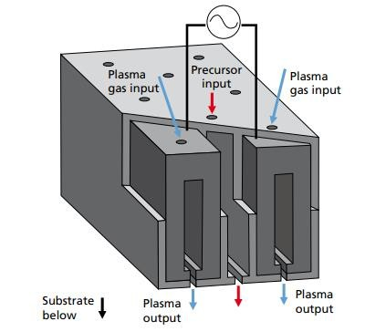
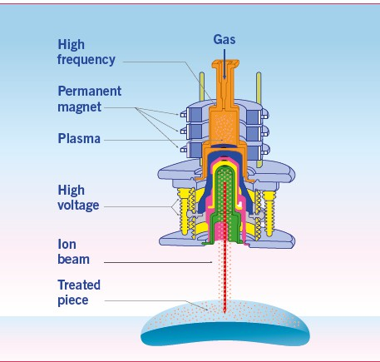
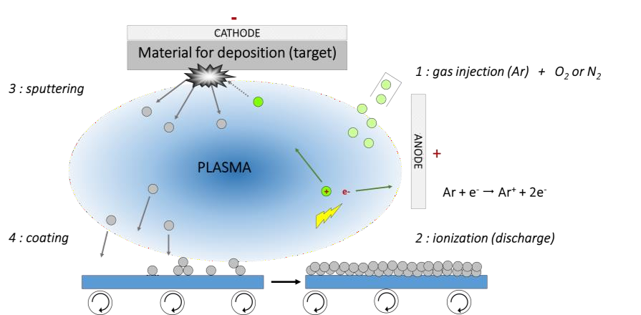
Expertise in PVD and PECVD technologies
Magnetron sputtering
Plasma Enhanced
Chemical Vapor
Ion implantation
Deposition
Deposition of metals, nitrides, carbides with coating uniformity
oxides,
superior
High rate deposition of oxides and oxynitrides with low internal stresses in the film
Surface modification by implantation of nitrogen ions into glass, metals or polymers
WWW.AGC-PLASMA.COM

Slide 14
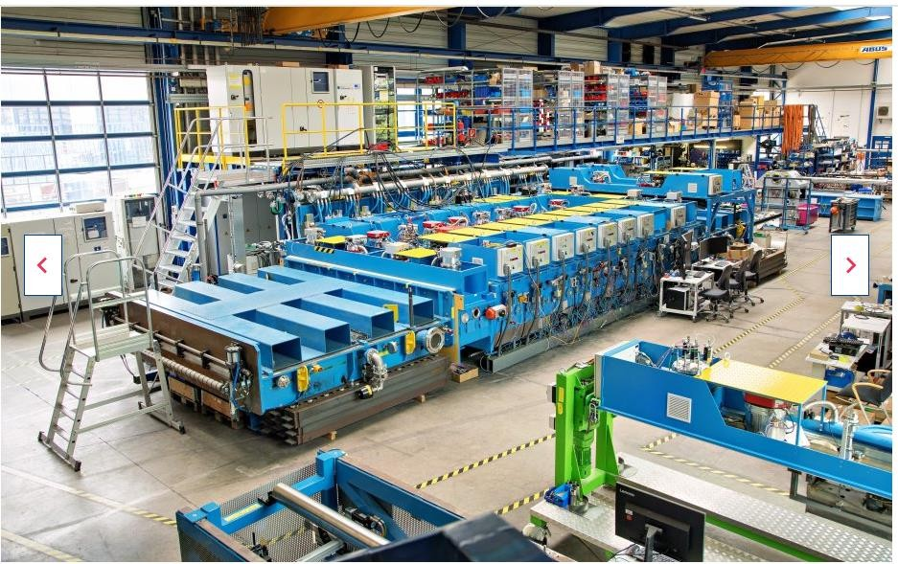
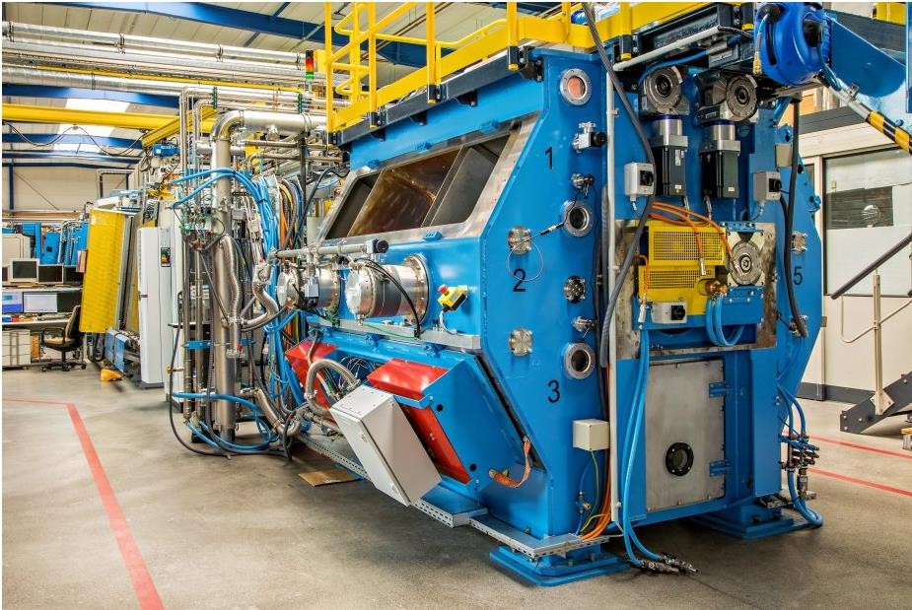
Offering access to demonstration center with S-to-S and R-to-R pilot coaters for test campaigns, proof-of-concept and prototyping services
Partnering with knowledge centers and start-up’s to upscale innovative PVD and PECVD technologies towards industrial scale equipment (engineering, manufacturing, installation, start-up)
Platinum sputtering capabilities as protective thin film coating for PTL and
BPP including glow discharge cleaning of the substrate prior to coating.
Partner in funded development projects:
NanoBloc (upscaling of anti-bacterial & anti-viral coating)
HeCO2 (methane pyrolysis)
Stellar (Lithium evaporation)
…

Slide 15
CENAERO

Slide 16
CENAERO in a nutshell
Belgian private nonprofit Research Centre (RTO)
Located in Charleroi (B) & Moissy-Cramayel (F)
85+ employees (PhD’s, skilled engineers)
Background in digital simulation for aeronautics
Operator of a 4 Pflops HPC
Pierre-Jean Fondu
Technology Transfer Officer
pierre-jean.fondu@cenaero.be
+32 470 633 475
www.cenaero.be

Slide 17
Expertise and value proposal in H2 :
Production process optimisation (Steam reforming, Electrolyse)
Multiphysics virtual prototypes based on fluid, thermal, electro-chemical models
Composite tank
Optimisation of a manufacturing process, specific to H2 tank and reinforcement parts design (confidential)
Reliability to impact assessment through probabilistic design (inc. delamination propagation-to-ruin)
Health management assessment based on sensors & predictive models
Critical component design
Valves & pipes : H2-tight cavity coating quality prediction
Additive Manufacturing process control and parts optimisation (i.e. electrodes structuration)
Conversion systems
Engine & Fuel cell design & optimization
Thermal management (incl. 2 phases flow technologies)
H2-to-buildings
Energy digital twins in buildings / cities
Energy management systems
Simulation environment for sizing production, conversion & storage units in (renewable) energy mix

Slide 18
A few collaborative projects (past & on going)
IIS e-WallonHY : Green H2 value chain development in Wallonia (from production to final application) : H2 to industry, H2 to mobility, H2 to building
Inoxypem : Fuel cell stack optimisation by thermochemical model
Loop-FC : Fuel cell control management
Enhance : Health management of composite structures (digital twin sensors/models)
Tioc-Wings :Impact behaviour prediction of composite structures
H2CS : Development of tools enabling the deployment and management of a multi-renewable energy community with hybrid storage
Wal-e-Cities : Energy digital twins in cities

Slide 19
GDTech

Slide 20
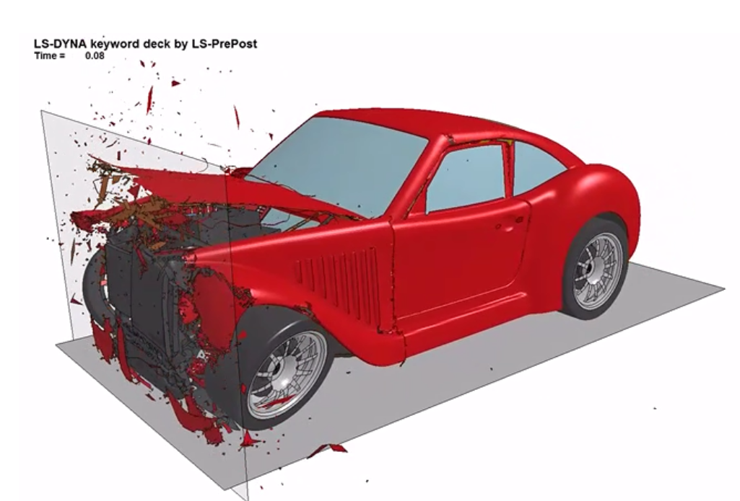
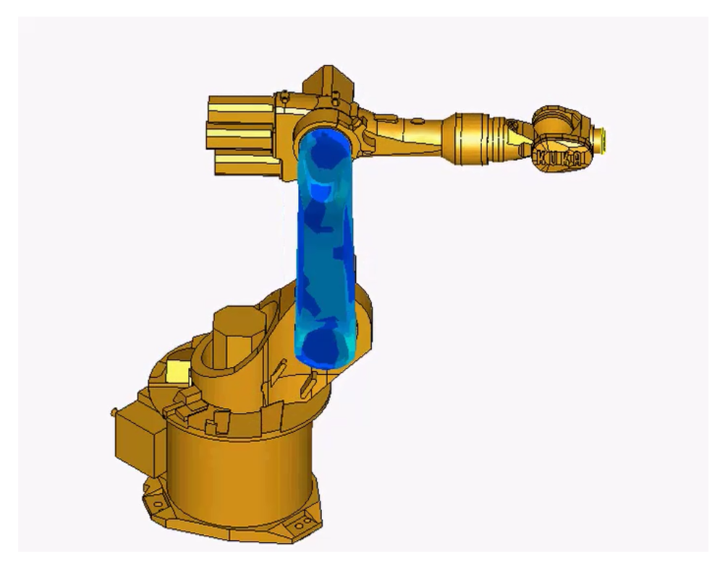
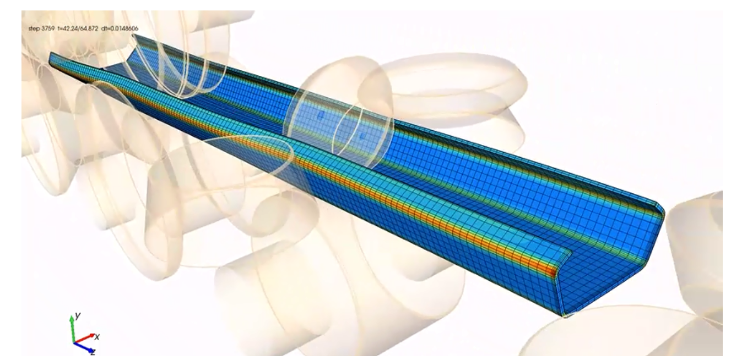
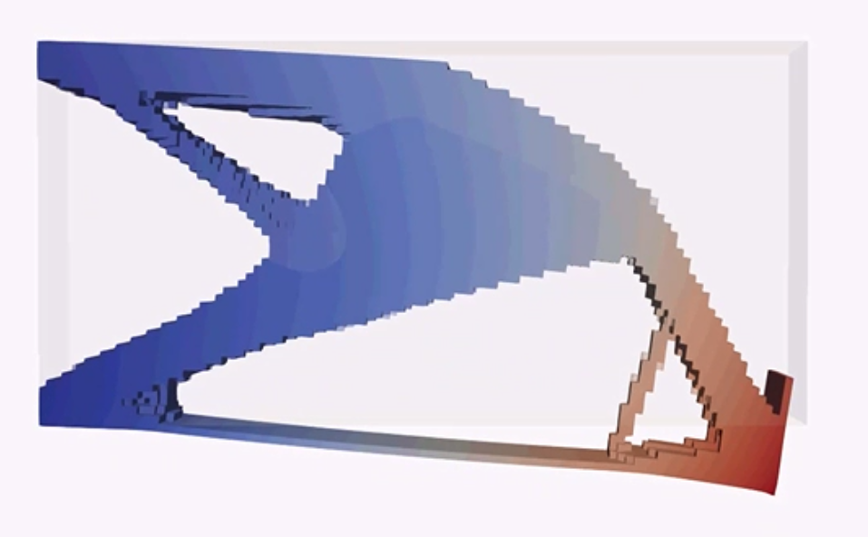
Michael Bruyneel
Michael.bruyneel@gdtech.eu
Scientific director
Global Design Technology – GDTech
SME – France (Pau) and Belgium (Liège)
www.gdtech.eu
Expertise: advanced modelling and simulation (0D/1D/2D/3D), multi-physics, digital twin, numerical optimization
HYVOLUTION
Booths 6C22 and 6D61

Slide 21
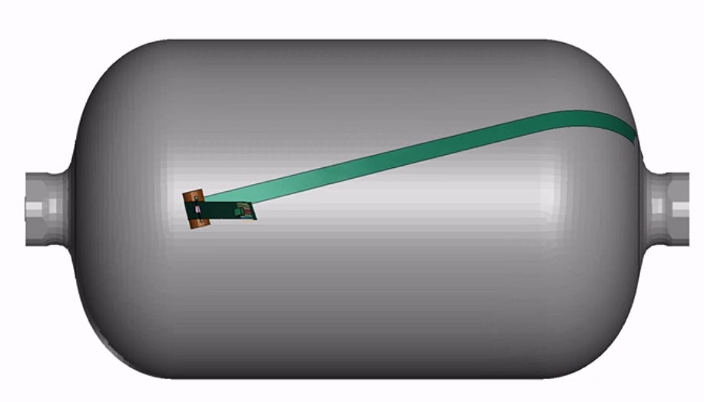
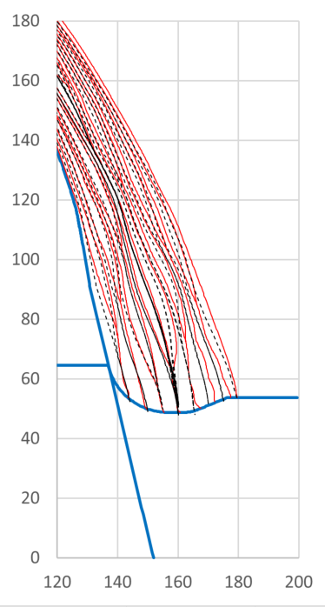
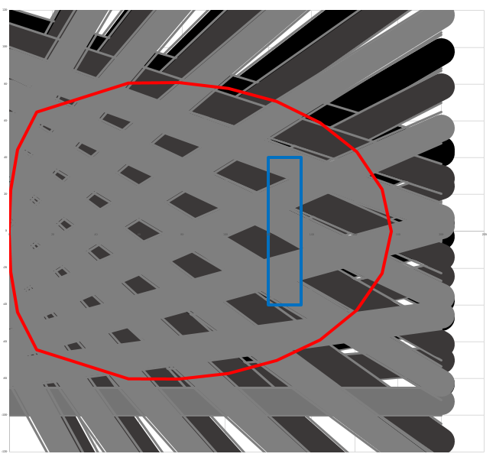
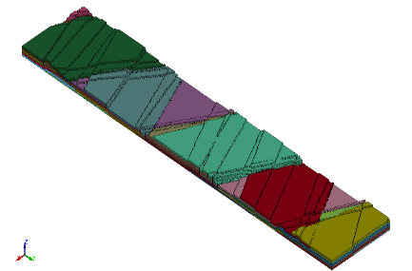
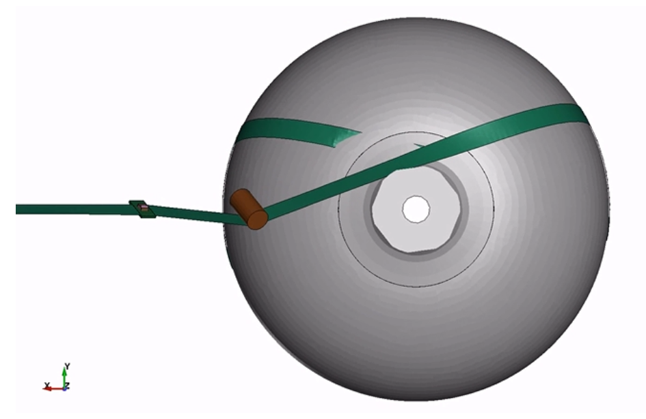
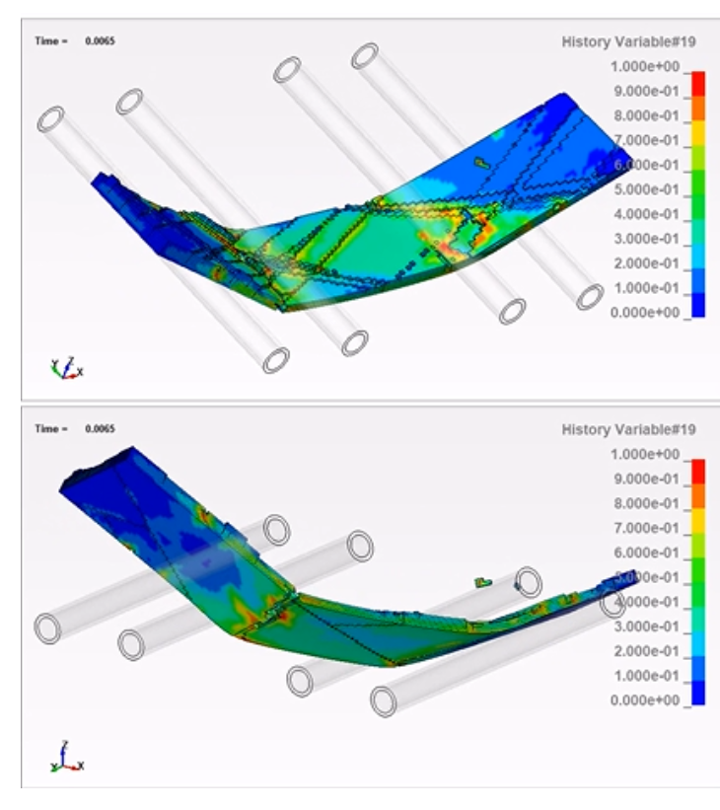
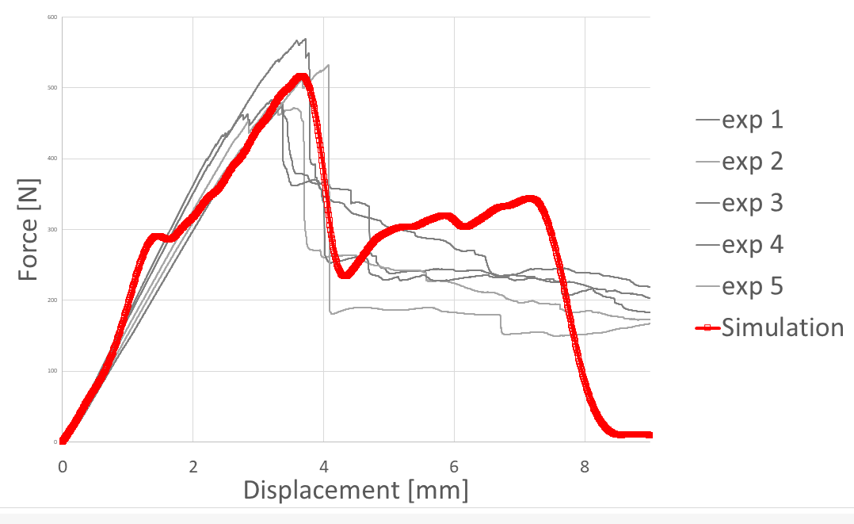
Competence offer: advanced modeling and simulation in the context of H2
Design and analysis of COPV (Composite Overwrapped Pressure Vessels):
Prediction of layer thickness, interaction with the boss (axisymmetric representation)
Finite Element simulation of Filament Winding process
Simulation of damage propagation up to failure in dome area (incl. characterization at coupon level)
Prediction
Measure

Slide 22
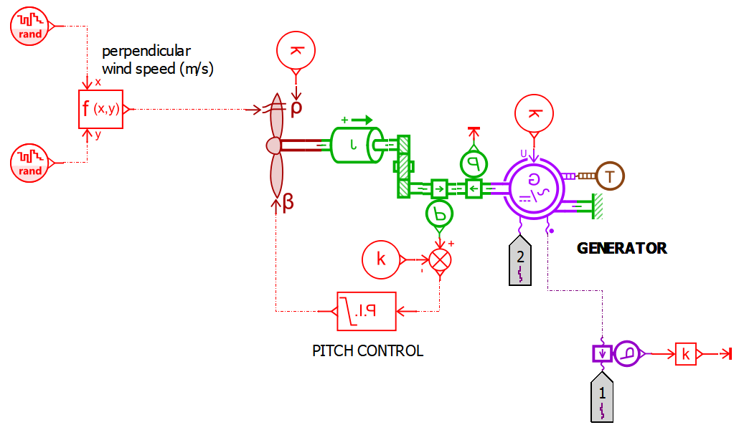
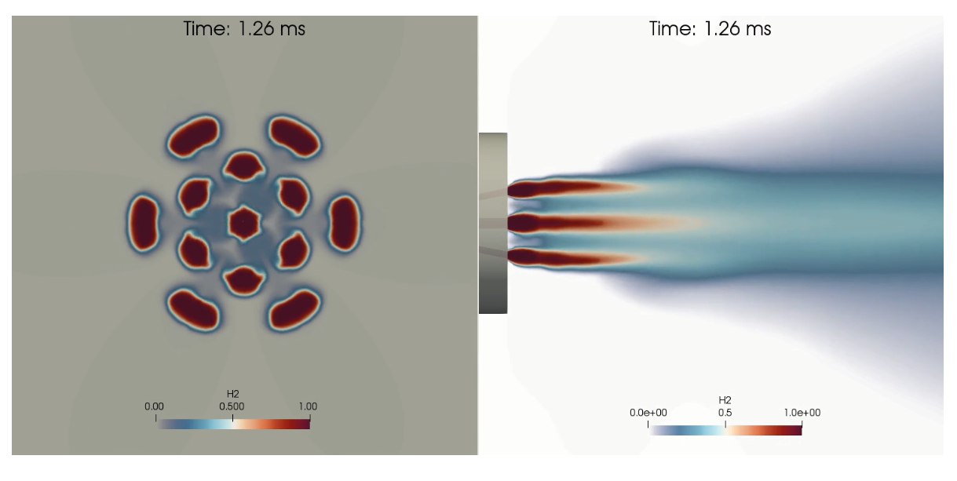
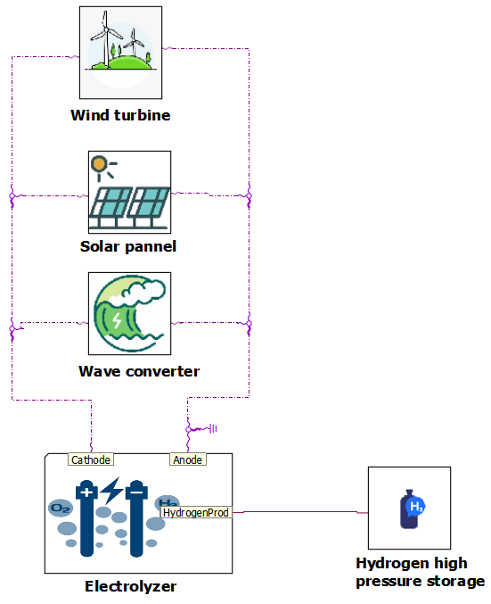
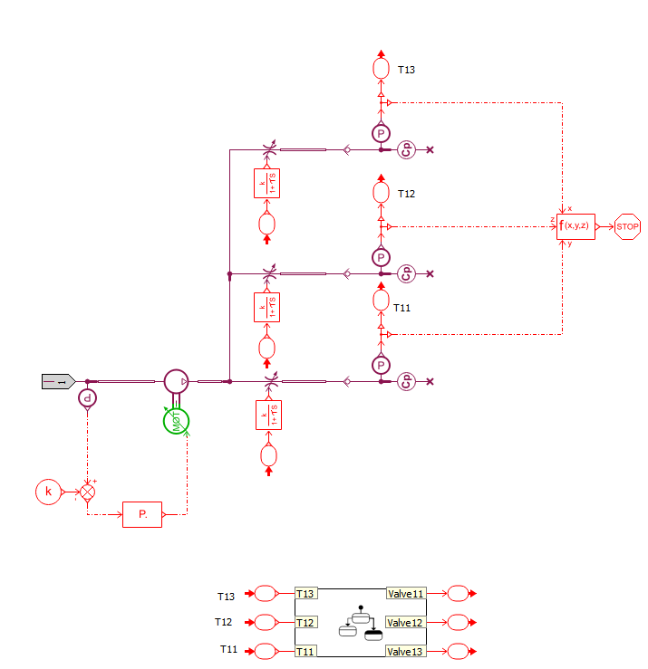
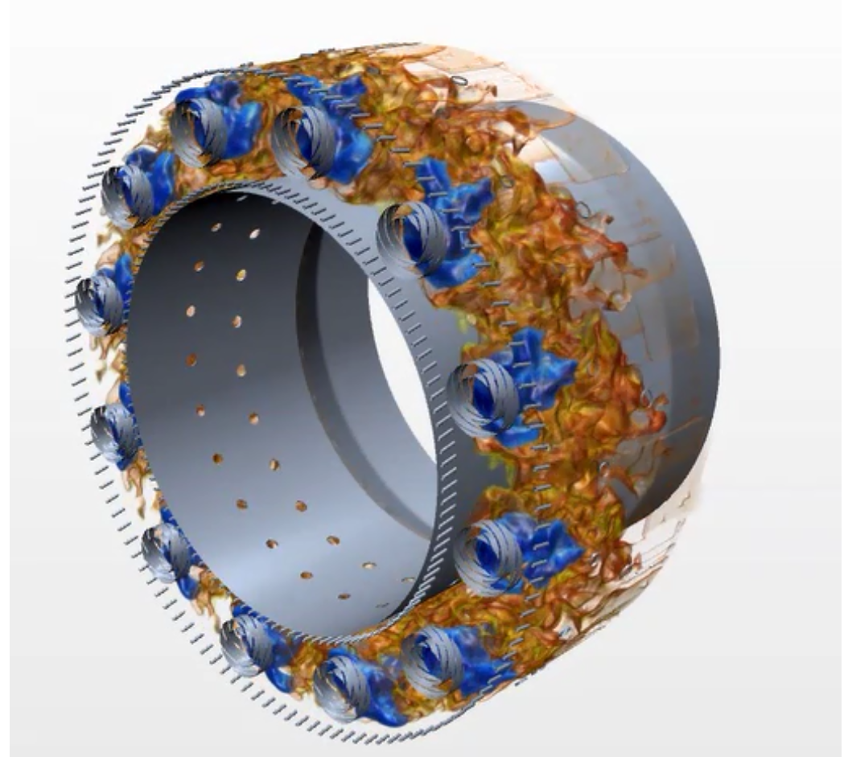
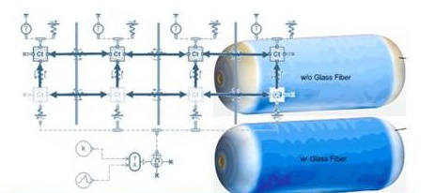
Competence offer: advanced modeling and simulation in the context of H2
System modeling (0D/1D)
From production to final use, via distribution and storage
Prediction of the electric power delivered by the turbine
CFD (Computational Fluid Dynamics)
Prediction of behavior inside the storage system
H2 injection
H2 combustion
Compressed and cryogenic tank design

Slide 23
ChemLabServices

Slide 24
Introduction:
Delphine SCHMITT
CHEMLABSERVICES SAS - SME
Project Manager
Chemical analyses expertise
Contact:
Email: chemlabservices@gmail.com
Phone:+33 6 81 75 50 61
https://chemlabservices.wixsite.com/chemlabservices

Slide 25
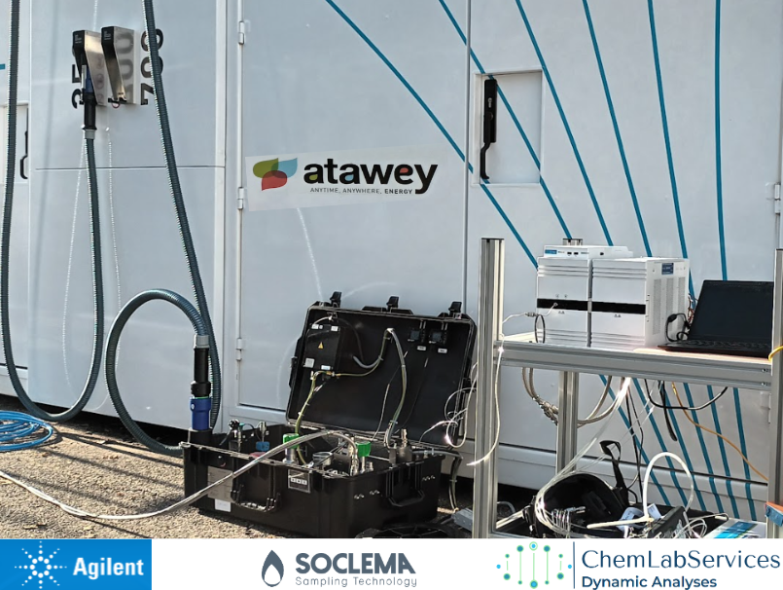
a competence offer :
MobHyLab, a tailor-made solution to check gas quality
Analytical services to support the development of hydrogen’s uses (ISO 14687 quality) for example at a hydrogen refueling station
Service transferable to other gases (biogas, CO2 capture and storage, etc.)
First time participation to call for projects

Slide 26
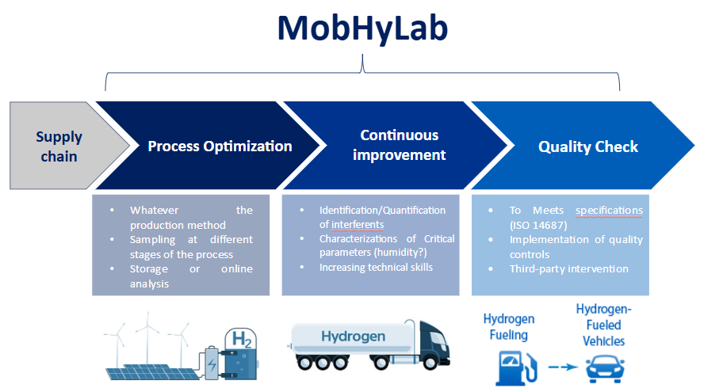
a competence offer : MobHyLab, a tailor-made solution to check gas quality

Slide 27
CRM Group

Slide 28
Ce template doit être rempli en anglais afin de pouvoir être ensuite facilement disséminé au plus grand nombre.
Pour rappel, vous devez remplir cette présentation et la renvoyer au PCN (pcn-climat-energie@recherche.gouv.fr) avant le 24 janvier 2025, 17H00 (UTC+1).
En cas d'un grand nombre de demandes, la sélection des pitchs sera faite en fonction de la date de réception des présentations.

Slide 29
LOGO
Name : Maïwenn LARNICOL
Organization : CRM Group, ASBL, R&D centre
Department : A3S/Hydrogen & Electrochemistry
The Expertise of this Department / team :
Product and process development : prototypes at pilot scale
Development of components for electrolyzers
Measurement of diffusible/total hydrogen, gas-metal interaction
Mechanical and corrosion characterization under hydrogen
Materials and components characterizations
Contact : maiwenn.larnicol@crmgroup.be (+32 474 24 52 12)
Web page : http://www.crmgroup.be/

Slide 30
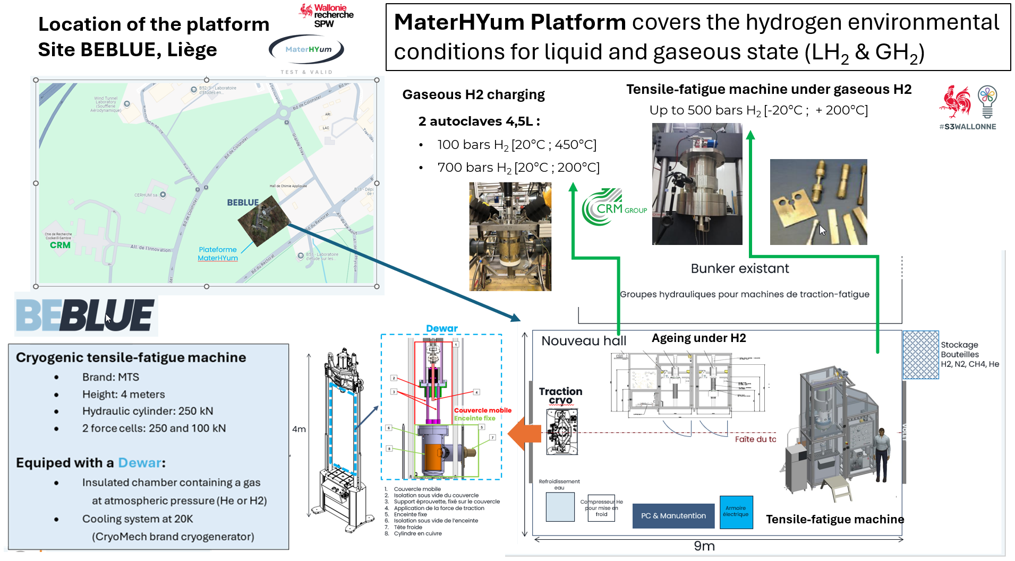
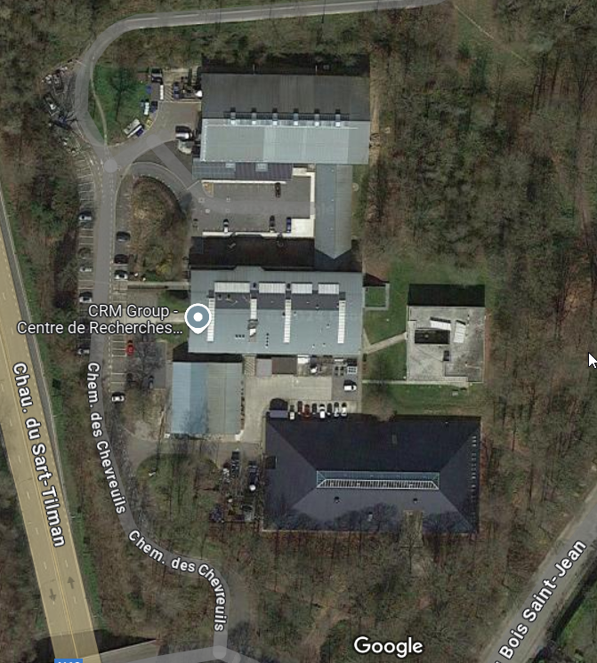
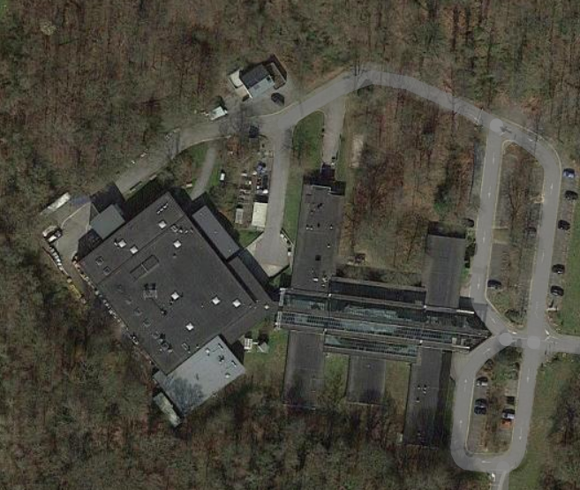
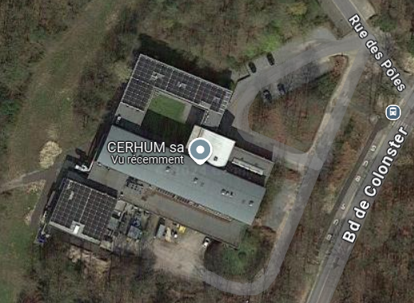
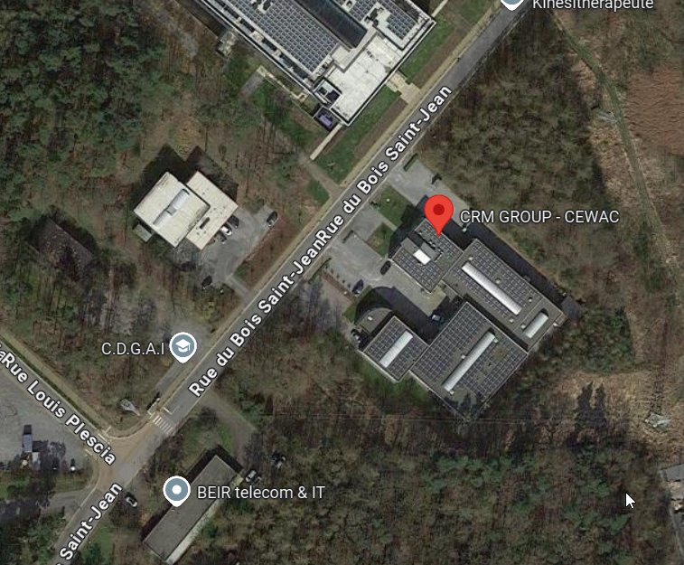
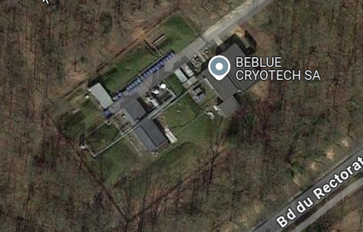
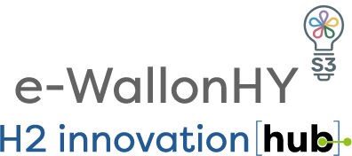
Test benches and R&D activities for addressing hydrogen challenges GH2 et LH2
Thermal Desorption Analysis Embrittlement
Electrolytic & gaseous charging
Electrolytic permeation
Electroplating
High Temperature H₂/H₂O steam interactions
Corrosion tests
Coating technologies booths Roll-to-roll pilot lines
Laser treatment
Tensile-fatigue machines
Hydroforming press
Dynamic Tube Rupture Test
at 10-100 bars
High Pressure permeation
up to 1000 bars
High Temperature permeation
up to 800°C
Alkaline Electrolyzer : cells and stack
Electrochemical devices & methods
Membrane development
1/27/2025
30

Slide 31
CHP25 : search of partners / consortium to join
HORIZON-JU-CLEANH2-2025-01-03: Scale-up and Optimisation of manufacturing processes for electrolyser materials, cells, or stacks
CRM Research activities
Development of innovative products to accompany industrial implementation: electrolyzer and fuel cell components; protocoles;
Development of barriers to hydrogen
Metal-hydrogen and metal-gas interactions
Our technical expertise
Upscaling technology : electrolyzer test benches
Electrochemical characterizations, benchmark of solutions
Coating deposition : roll-to-roll PL and 3D equipment
Surface finishing
Experimental data supply for lifetime assesment
HORIZON-JU-CLEANH2-2025-02-01: Development of mined, lined rock cavern for gaseous hydrogen storage
CRM Research activities
Understanding the impact of hydrogen on steel, including fatigue and fracture (capacity to perform low-cycle fatigue with large strain) and to deliver data to validate simulation based on rupture mechanics, fracture propagation, plasticity theory.
Research on steel corrosion, crevice corrosion, and hydrogen quality after storage and withdrawal.
Our technical expertise
Determining appropriate steel grades for hydrogen storage, including testing the impact of welds and residual stresses
Thermomechanical testing and crack propagation under hydrogen
Equipment and expertise to characterize corrosion
Desorption, permeation and embrittlement tests under hydrogen
HORIZON-JU-CLEANH2-2025-02-02: Development of cost effective and high-capacity compression solutions for hydrogen
CRM Research activities
Upscaling of technologies and development of innovative products for industrial implementation
Prototype building
High pressure testing expertise under various gases
Understanding of metal- hydrogen interaction and metal-gas interaction (H embrittlement)
Development of barrier to hydrogen and coatings with surface properties (low friction coating + characterization methods)
Permeation of materials under hydrogen
Post-mortem analysis and root cause analysis
Our technical expertise
3D equipment for low friction coating deposition
Surface finishing (mechanical, chemical and electrochemical)
Characterization of coating friction and wear.

Slide 32
MITIS

Slide 33
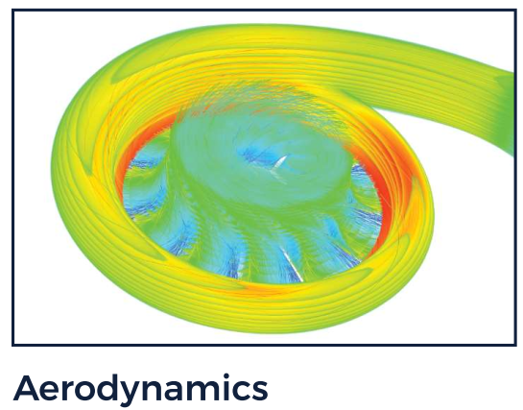
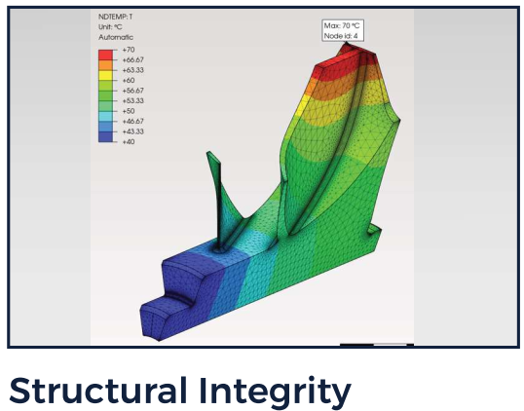
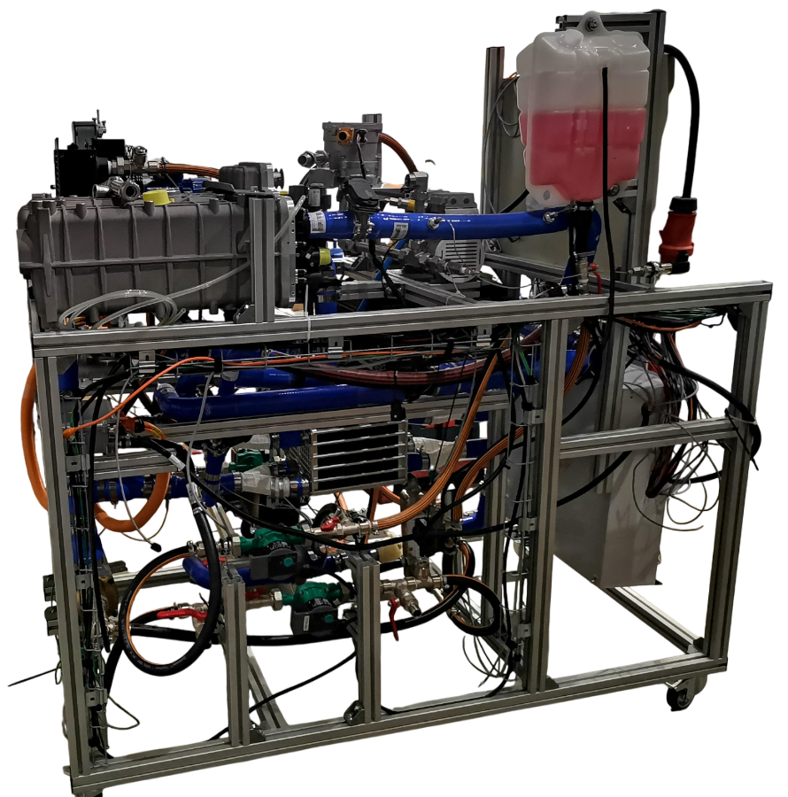
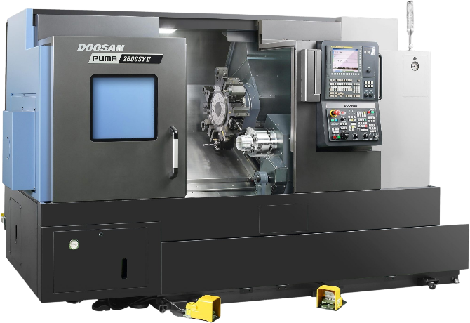
MITIS (booth 6C22)
Located in Liège (Belgium)
18 employees (SME)
Team R&D:
Construction and instrumentation of prototypes, tests
Numerical simulations (CFD, FEA), rotor dynamic, advanced modelling (Simulink,…)
Team industrialization:
Electronics (electronic board development, power management, …)
Design (P&ID, CAD, DFMEA,…) + Assembly
Manufacturing capabilities
Adrien Châtel Project engineer MITIS SA adrien.chatel@mitis.be +32 (0) 492 49 55 88 https://www.mitis.be/

Slide 34
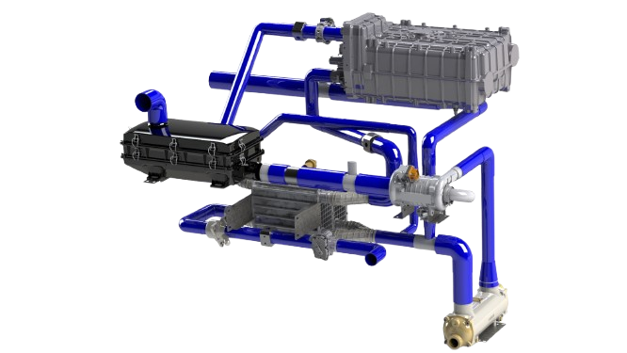
Our mission:
Develop new generation of decentralized power generators
Being clean and efficient
Renewable friendly
Our offer:
Multi-fuel flameless microgas turbine and PEM fuel cell
Services for technical problems or new developments
Innovative products for critical fluids or gas flameless combustion process
Innovation in sustainable energy as a high-tech manufacturer
Innovative test bench and prototype instrumentation
Our ambition: Reduce GHG and therefore mitigate the effects of climate change by means of new decentralized power generators

Slide 35
Projects:
Fit4Micro (Horizon Europe): coordinator
Hyguane (ESA founded project)
RESTORE (CET Partnership): coordinator
Cryogenic compander: industrial project
Prospects – looking for consortium partners in:
Aero and space market
Biogas/biofuels market
Energy transition projects (fuel cell in marine and stationary applications, micro-CHP, …)

Slide 36
UTAC

Slide 37
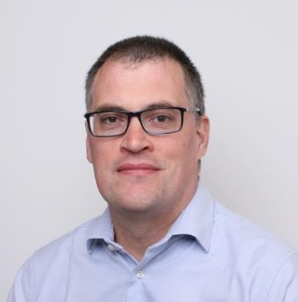
José FERNANDES
UTAC SAS
Technical service , vehicle test laboratory
Expertise department
Type Approval, testing
Contact:
jose.fernandes@utac.com/tony.perkins@utac.com
Tel:(+33) 6 43 32 24 53
https://www.utac.com/
Confidential Document

Slide 38
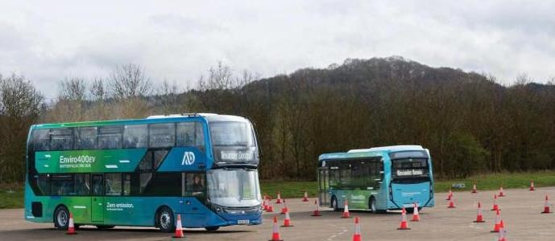
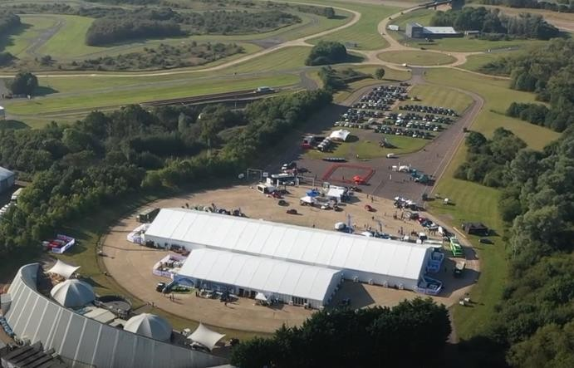
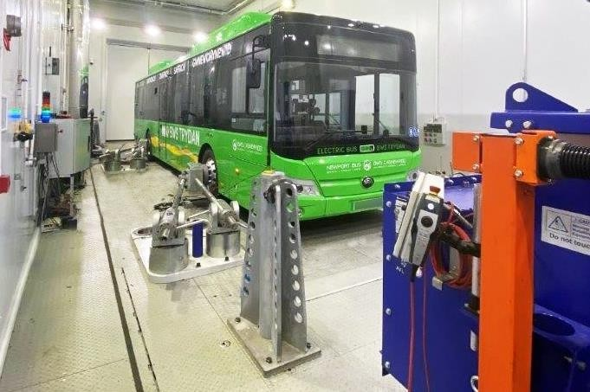
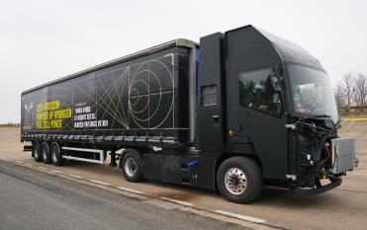
LOGO
Previous experience
Supporting bus manufacturers to certify their new technology buses.
Supporting SMEs and technology innovators, such as the
development of a hydrogen fuel cell truck.
Running events for customers to market their products.
Confidential Document

Slide 39
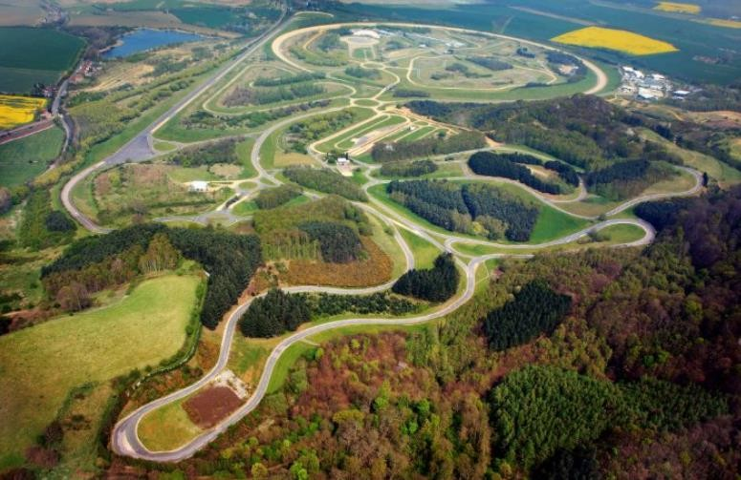
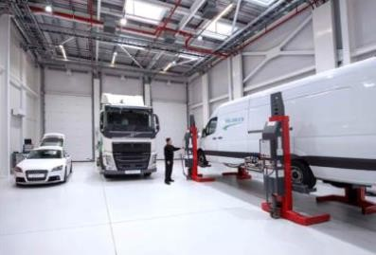
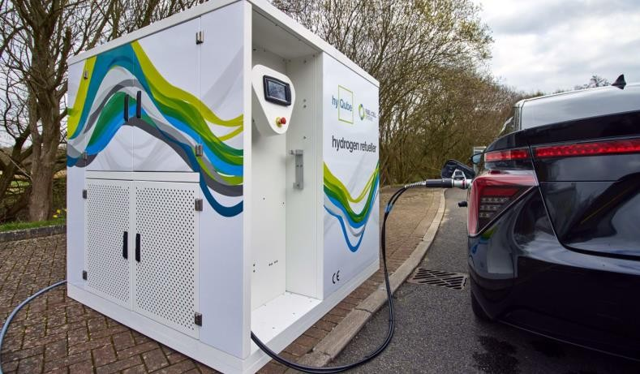
LOGO
Service offering for hydrogen vehicle development
Millbrook Proving Ground, UK & Mortefontaine, Montlhéry, FR
test tracks FR and UK
Suitable for passenger cars and heavy-duty vehicles
Off-road tracks
Workshops
Office space
Hydrogen refuelling to 350bar (700bar planned) in UK
Heavy-duty chassis dyno facility
Confidential Document

Slide 40
Saint-Gobain

Slide 41
Thin Films and Coatings Competencies of Saint-Gobain
Booth 4R92
Capucine TONG
R&D Engineer, PhD
capucine.tong@saint-gobain.com
Saint-Gobain
Industrial company founded in 1665.
Leader in construction and high-performance materials.
€47.9bn turnover in 2023.
Present in 76 countries.
160 000 employees.
Saint-Gobain Research (SGR)
8 R&D centers (4 in Europe): 4000 researchers.
Innovation efforts focused on customer needs.
Open innovation approach: Partnerships with start-ups, academic and corporate entities.
Thin Films Department
Magnetron sputtering & wet-deposition processes on various substrates
From small to large-scale coatings, innovation in materials and processing.
Pilot & Industrialization.
https://www.saint-gobain.com/

Slide 42
Materials we can deposit by magnetron sputtering
Booth 4R92
Target
Nano coatings
Targets: Ceramic & metal, various alloys + reactive gas for compounds.
Coating thickness range: 0.1 nm to > 1 µm
Porous and non-porous substrates: glass, polymer, ceramic, etc.
Ability to produce home-made targets of desired composition (www.coatingsolutions.saint-gobain.com)
https://www.saint-gobain.com/

Slide 43
Coating innovation capabilities at R&D level and global footprint
Booth 4R92
< 10 x 10 cm²
3.2 x 6 m²
R&D
Pilot line
Industrialization
Hydrogen focus areas:
Catalytic coatings
Protective coatings for bipolar plates
Gas permeation membranes
Etc.
https://www.saint-gobain.com/

Slide 44
Existing Saint-Gobain solutions for the Hydrogen market
Booth 4R92
https://www.saint-gobain.com/

Slide 45
Touch Sensity

Slide 46
TOUCH SENSITY
An innovative and patented technology to monitor the structural health state of a material :
Deeptech SME Company
Innovative Structural health monitoring solutions
Contact
Laetitia LAFFORGUE Laetitia.Lafforgue@touchsensity.com France +33 (0) 6 58 43 03 54
www.touchsensity.com
2D or 3D mapping of the material's structural state
Innovative peripheral instrumentation if needed
Connected system to stimulate the material and read its response (electrical signal)
Relative data: comparison with an initial or simulated state of the part
Data transmission to a terminal (PC, mobile device or in-vehicle)
Association with physical data
Low on-board system power consumption (mA and 5-12 V)
Touch Sensity :
Touch Sensity develops a new monitoring solution for the SHM market :
Global solution with internal and structural vision
Continuous monitoring and reversible and irreversible events detection
Since 2019 :
Touch Sensity has been working with over 25 European customers in the Aerospace, Defense, Energy, Railway, Naval and Automotive sectors.
With an experienced team of 15 people specializing in embedded systems, signal processing, materials characterization and mathematical algorithm development.
Complete data acquisition and analysis system raising alerts
Minimally invasive, robust, easy to integrate and adaptable to all sizes

Slide 47
SMART HYDROGEN TANK
Providing a Smart and Communicative Tank to industrials through its Monitoring.
Crack 3
MATURITY
TRL 6
Optimize sizing to iso-security :
Crack 2
Challenge current regulations
Reduce current security coef (2,5)
Crack 1
Increase security and safety
(while filing and in operation)
Reuse tanks into new vehicules
Assess rest lifetime
Reduce inspection costs
Provide Tanks Digital Passport :
During manufacturing On test benches
Manufacturing monitoring
Parameters optimization
Reduce material scrap
Data enhancement
Deepen material knowledge
Evaluate material health under mechanical stresses
During operation
During repair
Reduce maintenance costs
Optimize processes
Increase security
Reduce tanks replacement
Repairs’ historic
Healthy tanks reuse

Slide 48
SMART HYDROGEN TANK
Integrations :
Direct integration into the vessel materials: surface and
volume monitoring
Use of a coating (sprayed or deposited paint): surface monitoring and extrapolation for in-depth analysis
Information provided :
Altered zone localization
Damaged global state (ON/OFF)
Accurate localization
Alteration intensity
Solution characteristics :
Entire delamination and fiber breaks monitoring (from 1 cm)
Deep detection: swellings, scratches, shocks, cracks, etc.
Swelling monitoring (from 0.05%)
Temperature : - 40°C to 120°C
Lifetime : 300 000 fatigue validation cycles (for system and monitoring capability) equivalent to more than 20 years
PARTNERSHIP FOR COLLABORATIVE AND INDUSTRIALS PROJECTS :
Hydrogen tanks manufacturers (HP, liquid, etc.)
Vehicles manufacturers for tanks retrofit (monitoring, reuse, increase reliability, etc.)
Technological research centers (laboratories, tests, etc.)

Slide 49
HYCCO

Slide 50
Ludovic Barbès
Chief Industrial and Financial Officer
Co-Founder
Phone : +33 6 49 49 45 41
E-mail : ludovic.barbes@hycco.fr
www.hycco.fr

Slide 52
Partnerships
Past / current
MangabHy : hydrogen drone
Delair, ISAE, Pragma
RUP Estonia : portable power generator
PowerUP energy
NeGerHy : heavy duty Fuel cell
Illuming Power, Hynology
Joined development agreement
Siensqo, Arkema, Datwyler
Foreseen
Improvements in lifetime and cost of low temperature electrolysers by introducing advanced materials and components in stacks and balance of plant
HORIZON-JU-CLEANH2-2025-01-01

Slide 53
Institut de la Corrosion

Slide 54
https://www.institut-corrosion.fr/
Institut de la Corrosion is non-profit private research organization founded in 2002 (RTO)
56 coworkers (60% Ph.D. and engineers) on 3 sites (Brest, Saint-Etienne and Lyon).
Industrial and academic research in many industrial sectors, including hydrogen technologies.
Extensive expertise in European projects spanning from low to intermediate TRL.
Site of Brest: R&D activities on corrosion and corrosion protection in water electrolysis systems.
Site of Saint-Etienne: R&D activities on hydrogen material compatibility (transport and storage).
Bertrand Noharet – Business development bertrand.noharet@institut-corrosion.fr
29/01/2025

Slide 55
https://www.institut-corrosion.fr/
Examples of ongoing European projects:
“UNICORN” (CETP, 2023-2026, 7 partners) TRL 3-6, Development of the next generation of more cost-effective, more environmental-friendly PEM water electrolyzers.
“SWEETHY” (CHJU, 2025-2029, 9 partners) TRL 2-5, Direct seawater electrolysis technology for distributed hydrogen production.
Site of Brest: R&D activities on corrosion in water electrolysis (PEM / AEM)
Fully equipped electrochemistry laboratory: impedance spectroscopy, scanning Kelvin probe, …
Expertise in corrosion/durability tests for Bipolar Plates, Porous Transports Layers, Coatings
Long-term corrosion testing (>1000 h)
Development of accelerated stress tests
Interfacial Contact Resistance (ICR) measurements
Advanced physico-chemical methods for materials characterisation: SEM, EDX/WDX, Raman…
29/01/2025

Slide 56
https://www.institut-corrosion.fr/
Examples of ongoing European projects:
“CladPipe4H2” (CETP, 2025-2027, 8 partners) TRL 3-5, Clad pipes for safe and effective hydrogen storage and transport.
“HYSTORY” (RFCS, 2024-2027, 6 partners) TRL 2-5, Mn austenitic stainless and non- stainless steels for hydrogen applications: production, transport and storage.
“HENRI” (IPCEI, 2024-2026, 9 partners), Hydrogen energy reservoir.
Liquid amonia testing
Site of Saint-Etienne: Material qualification
for hydrogen and ammonia service
R&D services for low-carbon energies.
Full lab for hydrogen testing up to 700 bar
Full lab for liquid ammonia testing
High pressure hydrogen testing
Hydrogen and amonia permeation
Contact: Laura Moli Sanchez
laura.moli.sanchez@institut-corrosion.fr
/01/2025

Slide 57
TEMISTh

Slide 58
TEMISTh, YOUR THERMAL INNVOATION PARTNER From the idea to the manufacturing
Damien SERRET, R&D manager
General Informations
Workforce : 8
Status : PME
South of France
Turnover 2024 : 1M€
Thematic
Thermal management and optimization
Customers
Aeronautic, Space, Defense, Mobility, Energy
Heat Exchanger for Hydrogen, power-to-X and X-to-Power system
High pressure
High temperature
Compact and resistant to corrosion
European Cold plate manufacturer
High performance
On-demand
FSW / Additive Manufacturing process

Slide 59
Topics of interest in the next call
1. Renewable Hydrogen production
Innovative hydrogen and solid carbon production from renewable gases/biogenic waste processes (HORIZON-JU-CLEANH2-2025-01-06)
2. Hydrogen storage and distribution
Development of cost effective and high-capacity compression solutions for hydrogen (HORIZON-JU-CLEANH2-2025-02-02)
Demonstration of scalable ammonia cracking technology (HORIZON-JU-CLEANH2-2025-02-03)
Past European collaborative activities:
3 CLEAN SKY projects on heat exchangers and 1 H2020 project on CSP coupled to sCO2 cycle
Contact :
Damien SERRET, R&D Manager
+33 (0)6 13 53 56 06
Damien.serret@temisth.com
www.temisth.com
29/01/2025

Slide 60
Regions Ile de France/Normandie

Slide 61
maud.hainry@iledefrance.fr et frederique.vinay@iledefrance.fr
pauline.bonnard@normandie.fr
Ile-de-France / Paris Region
European and International Strategies
Unit
Normandy Region
Energy, Environment and Sustainable Development Unit

Slide 62
Hy2SEINE : the Seine hydrogen valley
Large-scale hydrogen valley – Clean Hydrogen Partnership
Support the development of the entire value chain of hydrogen on the Seine valley (Production, Storage, Distribution and Uses of hydrogen).
The Paris Ile-de-France Region (coordinator) and the Normandy Region.
Looking for partners developing hydrogen production projects, innovative SMEs and hydrogen off-takers. European partners or partners based in Paris Region or Normandy.
Sectors targeted : land mobility, waterborne transport, hydrogen towards eSAF, logistics platforms and construction equipment.
The Seine hydrogen valley

