Slide 1

Welcome
WiFi​
Nom du réseau/login : ​GTN4_HE2023​
Mot de passe/passwords : ​
GTN_CL4_06oct23​

Slide 2

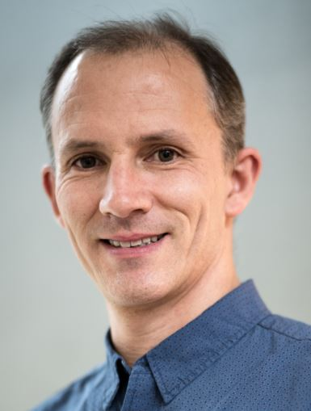

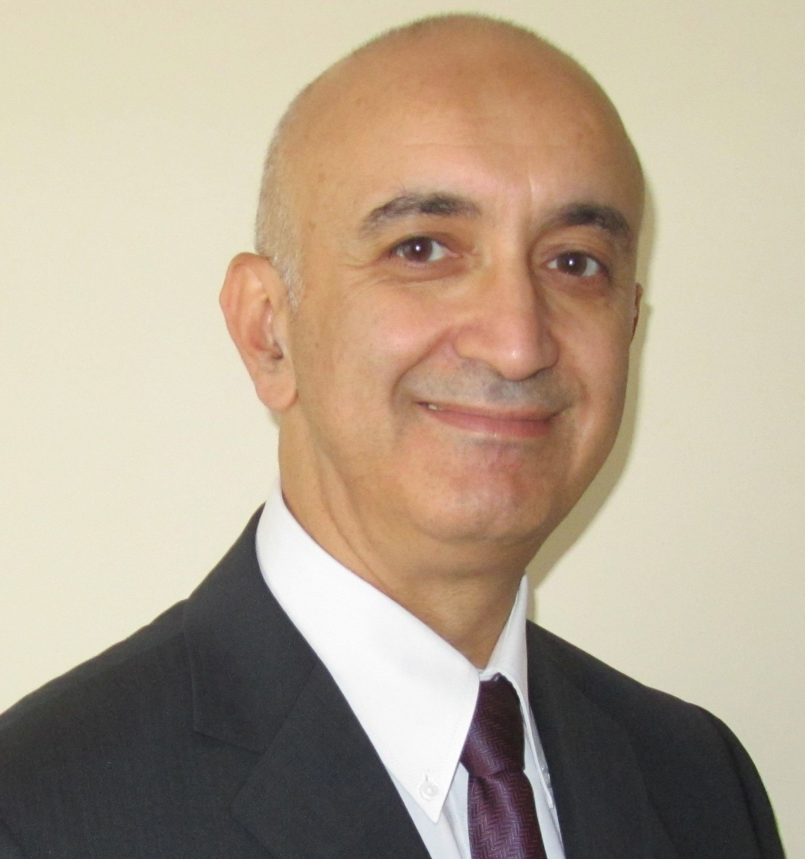
One-stop-shop for Horizon Europe programme among the French research, and innovation community
French Digital National Contact Point Team (NCP)
Informing, raising awareness, and guiding candidates
Targeting European stakeholders and facilitating emerging project ideas
Training networks (geographic and thematic)
Supporting European and beyond matchmakings (under our digital NCP network of networks)
Communicating in a dedicated HE section on cluster 4 (Pillar II) Digital
Isabelle
De Sutter
MESR
Gaël
Maugis
MESR
Hélène
Dereszowski
MESR
Smail
Niar
MESR
More information: https://www.horizon-europe.gouv.fr/numerique-cluster4
Contact us: pcn-tic@recherche.gouv.fr

Slide 3
w

Slide 4
Agenda
Morning plenary session 9:30 - 9:40: Introduction Patrick Nedellec and programme of the day 9:40 - 10:00: Keynote session Matthieu Delescluse (European Commission – DG Connect) 10:00 - 11:00: Presentation of the Cluster 4, Digital call 2024 - Horizon Europe 11:00 - 11:10: Q&A 11:10 - 11:30: Presentation of financial support schemes for French coordination projects 11:30 - 11:45: Break )

Slide 5
Workshops with pitching – 3 parallel sessions – 11:45 – 13:15
13:15 - 14:30: Lunch buffet and Networking at the Hall de la poule (Pavillon Foch)
Atelier 1 : AI/Data/Robotics - 6 sujets | Atelier 2 : CPS/Cloud/Edge - 6 sujets | Atelier 3 : Photonics/Quantum/Graphene /Nanoelectronics - 6 sujets
Animation : Smail Niar + Okke Scholten (NL digital NCP) Amphithéâtre Poincaré (Foch) | Animation : Gaël Maugis + Leonardo Tonetto (LX digital NCP Salle : Germaine Tillon (Joffre) | Animation : Géraud Canet + Rebekka Vedina (EE digital NCP) Salle : Jean Daucet (Foch) ou Langevin L005

Slide 6
Agenda
Afternoon: 14:30 - 16:00 Meeting with NCPs, by prior arrangement only
L'après-midi : Uniquement sur Rendez-vous confirmé - 14:30 – 16:00
L'examen des pré-propositions Choix d'un thème, d'un consortium, d’une idée générale (15 min) RDV individuel | Evaluation juridique et financière des pré-propositions Questions générales/règles administratives et financières, etc. (10 min) | Assistance à la création de votre profil sur la plateforme B2Match de Networking Atelier : conseils précieux pour accroitre sa visibilité et ses recherches de partenaires
PCN numérique IDEAL-IST* Horaire et salle à confirmer après l’émargement à l’accueil Salles : Jean Daucet (Foch) + Langevin L003 à L007 | PCN Juridique et Financier Salle : Langevin L002 | Réseau EEN TONIC Animatrice : Daniela ONOFRI Salle : Germaine Tillon

Slide 7

Introduction
Patrick NEDELLEC Délégation aux affaires européennes et internationales (DGESIP DGRI B - DAEI) European and International Affairs Delegation

Slide 8

Keynote Speaker
Matthieu DELESCLUSE Deputy Head of Unit at European Commission (CNECT.D.1) Digital: Research Strategy and Programme Coordination

Slide 9
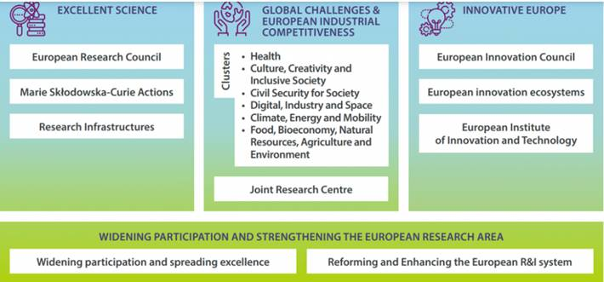

Slide 10
Type of actions eligible for funding
3 kinds of collaborative projects Funding rate 100 % (RIA and CSA); Funding rate 70% IA (except for non-profit legal entities, where a rate of up to 100% applies) RIA – Research and Innovation Actions (TRL 2-5 at the end of the projet) Activities to establish new knowledge or to explore the feasibility of a new or improved technology, product, process, service or solution: basic and applied research, technology development, small-scale prototype testing… IA – Innovation Actions (TRL 5-8 at the end of the projet) Activities to produce plans and arrangements or designs for new, altered or improved products, processes or services: prototyping, testing, demonstration or pilot, large-scale product validation, initial commercialization... CSA – Coordination and Support Actions Activities that contribute to the objectives of Horizon Europe : networking, communication actions and awareness raising, policy dialogue, production of studies/ reports, strategic planning

Slide 11
Eligibility
Collaborative projects
At least one independent legal entity established in a Member State At least two other independent legal entities each established in a different Member State or an Associated Country Note: In each calls, specific conditions may appear (more partners, other mandatory and/funded countries, etc.).

Slide 12
Horizon Europe - Digital
AI/Data/Robotics Topics
Opening: 15 Nov 2023
Deadline(s): 19 Mar 2024

Slide 13
AI/Data/Robotics
HORIZON-CL4-2024-DATA-01-01
AI-driven data operations and compliance technologies (AI, data and robotics partnership) (IA)
        8 to 10 M€ per project - 4 projects funded (38 M€) - start at TRL 4-5 and end at TRL 6-7
        Provide Common European data spaces and AI data provision with reliable mechanisms to monitor, control and track/record transactions on data, to ensure compliance

Slide 14
AI/Data/Robotics
HORIZON-CL4-2024-DIGITAL-EMERGING-01-03
Novel paradigms and approaches, towards AI-powered robots– step change in functionality (AI, data and robotics partnership) (RIA)
        8 M€ per project - 4 projects funded (30 M€) - start at TRL 2-3 and end at TRL 4-5
        Stand out from leading-edge solutions and meet more complex functional challenges, in particular make a significant enhancement to the navigation capabilities
HORIZON-CL4-2024-DIGITAL-EMERGING-01-04
Industrial leadership in AI, Data and Robotics boosting competitiveness and the green transition (AI Data and Robotics Partnership) (IA)
        10 M€ per project - 5 projects funded (60 M€) - start at TRL 3-5 and end at TRL 6-7
        Contribute to 1 of the following 2 outcomes: Creation of systems to address large scale challenges
        Using combined robotics data and AI solutions
        Using combined AI and data solutions

Slide 15
AI/Data/Robotics
Deleted
HORIZON-CL4-2024-HUMAN-01-06:
Explainable and Robust AI (AI Data and Robotics Partnership) (RIA)
        9 to 10 M€ par project - 3 projects funded (30 M€) - start at TRL 2-3 and end at TRL 4-5
        Contribution to one of the following outcomes:
          Enhanced robustness, performance and reliability of AI systems
          Improved explainability and accountability, transparency and autonomy of AI systems
HORIZON-CL4-2024-HUMAN-01-07:
Collaborative intelligence – combining the best of machine and human (AI Data and Robotics Partnership) (RIA)
        Around 5 M€ per project - 4 projects funded (20 M€) - start at TRL 2-3 and end at TRL 4-5
        Demonstrate the value of human-machine collaboration and interaction and
        Demonstrate how collaborative decision-making improves over human decision-making
EC intends to cancel the 2 topics : HORIZON-CL4-2024-HUMAN-01-06 & 01-07:
Need to introduce a new call, fast evolving trend on AI, (generative AI), sufficient critical mass.
• HORIZON-CL4-2024-HUMAN-01-61 (CSA), postponed, unchanged,
opened around April 2024.

Slide 16
AI/Data/Robotics
New topic (Draft)
HORIZON-CL4-2024-HUMAN-03-01: Advancing Large AI Models: Integration of New Data Modalities and Expansion of Capabilities (AI, Data and Robotics Partnership) (RIA)
Opening: 16 Apr 2024 Deadline(s): 18 Sep 2024, Around 26.5 M€ per project - 2 projects funded (53 M€)
Expected Outcome: 1 of the following outcomes:
        Enhanced applicability of large AI systems to new domains by integration of innovative data modalities, ex : sensor measurements in robotics, IoT, remote sensing (earth observation), as input.
        Improvement of current multimodal large AI systems capabilities (more data modalities), leading to broader application potential and improved AI performance.
        Proposals should address at least 1 of the following focus areas:
Integration of innovative modalities of data as input for large AI models:
  Event streams, structured data and sensor measurements. Enhancements to model performance and enable their application in new domains: weather forecasting, robotics, production and manufacturing.
  Enhanced multimodal models, exceed the current SotA, improved capabilities or the ability to handle a larger number of modalities

Slide 17
Horizon Europe - Digital
CPS/Cloud/Edge
Opening: 15 Nov 2023
Deadline(s): 19 Mar 2024

Slide 18
CPS/Cloud/Edge
HORIZON-CL4-2024-DATA-01-03
Piloting emerging Smart IoT Platforms and decentralized intelligence (IA)
        20-25 M€ per project - 2 projects funded (45 M€) - start at TRL 3-4 and end at TRL 6-7
        Development of systems to become open platforms underpinning an emerging open edge ecosystem including midcaps, SMEs and start-ups that foster edge solutions
HORIZON-CL4-2024-DATA-01-05
Platform Building, standardisation and Up-scaling of the ‘Cloud-Edge-IoT’ Solutions (CSA)
        2 M€ per project - 1 project funded (2 M€)
        International collaboration with trusted partner regions, guaranteeing a minimum level of interoperability, portability thereby fostering competition in the Cloud/Edge services market for the European cloud/edge and software industry
        and facilitate European access to foreign markets

Slide 19
CPS/Cloud/Edge
HORIZON-CL4-2024-DIGITAL-EMERGING-01-21
Open Source for Cloud/Edge to support European Digital Autonomy (RIA)
        4-6 M€ per project - 4 projects funded (20 M€) - start at TRL 4 and end at TRL 6
        Facilitate the emergence of a full European Open Cloud and Edge Computing Architecture
HORIZON-CL4-2024-DIGITAL-EMERGING-01-22
Fundamentals of Software Engineering (RIA)
        4-6 M€ per project - 4 projects funded (13,5 M€) - start at TRL 2 and end at TRL 5
        Implementing responsible software engineering (optimising energy usage, reducing the environmental footprint, security-by-design, and data protection) by demonstrating their developments in at least three industrial or societal use-cases

Slide 20
CPS/Cloud/Edge
HORIZON-CL4-2024-DIGITAL-EMERGING-01-23
Public recognition scheme for Open Source (CSA)
        2M€ per project - 1 project funded (2 M€)
        Develop a scheme including a list of fields related to Open Source (deep contributions to kernel code, brilliant utilization of open source in companies) => Annual award
HORIZON-CL4-2023-HUMAN-01-61
Facilitate the engagement in global ICT standardisation development (CSA)
        Around 6 M€ per project - 1 project funded (6 M€)
        Share information about global sectorial ICT standardisation ecosystems and engagement of European stakeholders in global standardisation settings

Slide 21
Horizon Europe - Digital
Photonics/Quantum/Graphene/Nanoelectronics
Opening: 15 Nov 2023
Deadline(s): 19 Mar 2024

Slide 22
Photonics/Quantum/Graphene/Nanoelectronics
HORIZON-CL4-2024-DIGITAL-EMERGING-01-54
Smart photonics for joint communication & sensing and access everywhere (Photonics Partnership) (RIA)
        3-5 M€ per project - 4 projects funded (18 M€) - start at TRL 2 and end at TRL 5
        Photonics for communication network
HORIZON-CL4-2024-DIGITAL-EMERGING-01-55
Photonics Innovation Factory for Europe (Photonics Partnership) (IA)
        15 M€ per project - 1 project funded (15 M€) - start at TRL 2-5 and end at TRL 4-7
        provide a virtual factory with a flexible and open structure, allowing for a multiplicity of competitive actors and services, fully integrated European ecosystem of cross-border deep innovation support in core photonics technologies for the benefit of European industry

Slide 23
Photonics/Quantum/Graphene/Nanoelectronics
HORIZON-CL4-2024-DIGITAL-EMERGING-01-31
Pilot line(s) for 2D materials-based devices (RIA)
        33 M€ per project - 1 project funded (33 M€) - start at TRL 2-3 and end at TRL 4-5
        Accessible pilot line(s) fostering the creation of electronic and photonic devices and systems (co-)integrating two-Dimensional Materials (2DM)
HORIZON-CL4-2024-DIGITAL-EMERGING-01-34
Synergy with national and regional initiatives in Europe (CSA)
        3 M€ per project - 1 project funded (3 M€)
        Well-coordinated European, national and regional initiatives in the field of graphene and two-dimensional materials (2DM)

Slide 24
Photonics/Quantum/Graphene/Nanoelectronics
HORIZON-CL4-2024-DIGITAL-EMERGING-01-42
Stimulating transnational research and development of next generation quantum technologies, including basic theories and components (Cascading grant with FSTP) (RIA)
        15 M€ per project - 1 project funded (15 M€) - start at TRL 1-4 and end at TRL 6
        Support to transnational projects in QT, synergy between EU, national and regional initiatives and promoting broader partnerships between the EU stakeholders in QT
HORIZON-CL4-2024-DIGITAL-EMERGING-01-45
Quantum sensing and metrology for market uptake (IA)
        4-5 M€ per project - 3 projects funded (15 M€) - start at TRL 4-5 and end at TRL 6-7
        Contribute to mature Q sensing technologies and devices in different application sectors

Slide 25
Horizon Europe - Digital
AI/Data/Robotics Topics
Pitch session

Slide 26
HORIZON-CL4-2024-DATA-01-01: AI-driven data operations and compliance technologies (AI, data and robotics partnership) (IA)
Data sharing and analytics capacity
4 projects | 8-10 M€ | IA | TRL 4-5 to 6-7
Proposals should build on :
  H2020 (ICT-13-2019)
  HE CL4 (2021-DATA-01-01 and 2023-HUMAN-01-01)
Employ appropriate technologies and methods (federated and distributed AI/analytics )
Associate them with trustworthy AI techniques; protect privacy and confidentiality of AI training data and reduce energy footprint.
The competences represented in the consortium should cover all the relevant aspects (technical, legal, commercial, societal, ethical)
Expected results
To enable companies and public sector to easily comply with existing and emerging regulation and create value on data assets
Shorten the time-to-market and reduce development costs of compliant data solutions
Contribute to open, trusted and federated Common European data spaces
Quantify and reduce the environmental footprint of data operations

Slide 27
HORIZON-CL4-2024-DIGITAL-EMERGING-01-03
Novel paradigms and approaches, towards AI-powered robots– step change in functionality (AI, data and robotics partnership) (RIA)
AI, Data and Robotics
Around 8M€ per project | 4 projects | RIA | TRL 2-3 to 4-5
Improve the functional performance such as accuracy, strength, speed, planning, physical perception, grasping, or manipulation
Take into account safety and security aspects, as well as the data life cycle
Example of application sectors
manufacturing, assembly, energy, transportation infrastructures, medicine and healthcare, materials processing and microfabrication
Multidisciplinary research is important
Should address several of the following points:
- Integration of sensing into physical structures to improve motion and perception
- Advanced navigation capabilities to move in dynamic and complex environments
- Mobile manipulation, with dexterity, of very small, large, soft and complex objects
- Natural human-robot interaction features
- Advanced cognitive capabilities, integrating any kind of learning or reasoning
- New design approaches, e.g. soft robotics, under-actuated, miniaturized and modular robots
Expected results
Ability of robots to perform novel functional tasks in realistic environments
Interact with humans, and improve robustness and safety
Guarantee the sovereignty of key robotics technologies
Maintain the scientific excellence in
Address general societal challenges.

Slide 28
HORIZON-CL4-2024-DIGITAL-EMERGING-01-04:
Industrial leadership in AI, Data and Robotics boosting competitiveness and the green transition (AI Data and Robotics Partnership) (IA)
AI, Data and Robotics
5 projects | 10 M€ | IA | TRL 3-5 to 6-7
Contribute to one of the following two outcomes, exclusively:
sub-area A:
Creation of systems using combined robotics, data and AI
sub-area B:
Creation of systems using combined AI and data solutions
Financial support to third parties - FSTP only in sub-area B
200 K€ is the maximum amount to be granted to each third party
40% of the budget
Must share results through the AI-on-demand platform and/or the Digital Industry Platform for Robotics.
Must demonstrate the added value of technology integration, through large-scale validation scenarios reaching a critical mass and contributing to Green Deal.
Multidisciplinary innovation activities must address one of the following A or B:
Large-scale pilots bringing together to exploit and integrate existing tools, subsystems and existing solutions that can be reused in other sectors
Large-scale pilots of green impact applications addressing key challenges in AI, data and robotics deployment.
Must include a clear business case and operating strategy
Expected results
Validate solutions at scale by demonstrating the potential of technology integrating to meet the industrial ecosystem challenges and to contribute to the green deal.
Explore scientific and technological breakthroughs to maintain scientific excellence and ensure sovereignty in key technologies.
Boost the use of AI, data and robotics to contribute to environmental sustainability.

Slide 29
HORIZON-CL4-2024-HUMAN-01-06: DELETED
Explainable and Robust AI (AI Data and Robotics Partnership) (RIA)
Leadership in AI based on trust
9-10 M€ per project | 3 projects | RIA | TRL 2-3 to 4-5
Must address all of the following:
- involve appropriate expertise in all relevant disciplines including gender and intersectional knowledge
- Provide tasks and resources to collaborate and contribute to the HORIZON-CL4-2023-HUMAN-01-04 open innovation challenge addressing explainability and robustness.
- Contribute to ensuring that AI and robotics solutions meet the requirements of trustworthy AI.
International cooperation is encouraged, in particular with Canada and India.
AI algorithms capable of operating safely under a variety of real-world conditions
Advance robustness and explainability, while resulting in an acceptable loss of accuracy and efficiency, and with known verifiability and reproducibility
The following methods may be considered, but are not required:
efficient data learning, reinforcement learning, federated and edge learning
hybrid approaches of neuromorphic computing, approaches inspired by nature, …
continuous learning, active learning, multimodal learning, natural language processing, speech recognition, and reading comprehension
Expected results
Must contribute to one of the following outcomes:
Improved robustness, performance, and reliability of AI systems, as well as awareness of system operational robustness limitations.
Improved explainability and accountability, transparency, and autonomy of AI systems, as well as awareness of system working conditions

Slide 30
HORIZON-CL4-2024-HUMAN-01-07: Deleted
Collaborative intelligence – combining the best of machine and human
(AI Data and Robotics Partnership) (RIA)
Leadership in AI based on trust
~5M€ per project | 4 projects | RIA | TRL 2-3 to 4-5
Proposals should clearly state which of these two areas they address:
Collaboration and human-computer interaction
Collaborative decision making
At least one proposal from each area will be selected
Involve expertise in SSH
Build on existing standards or contribute to standardization
Build on existing projects
↔ HORIZON-CL4-2023-HUMAN-01-04
Share results through the on-demand AI platform or the digital industry platform for robotics
The work should focus on
Fundamental research towards the next generation of collaborative AI
Simulations and experimentation with and without humans in the loop
Integration of advances in human-computer interaction and automatic reasoning
Verification of applicability to a wide range of domains
Expected results
Proposals are expected to address at least one of the following outcomes
Demonstrate that human-machine collaboration improves effectiveness, intuitiveness, efficiency, completeness and other subjective, objective or quantifiable measures.
Demonstrate that collaborative decision making improves human decision making and covers all stages of reasoning (data collection, analysis, reasoning and communication)

Slide 31
HORIZON-CL4-2024-HUMAN-03-01:
????
(AI Data and Robotics Partnership) (RIA)
Leadership in AI based on trust
M€ per project | 2 projects | RIA | TRL 2-3 to 4-5
T...
Expected results
Proposals are expected to address at least one of the following outcomes
….Expected Outcome: 1 of the following outcomes:
Enhanced applicability of large AI systems to new domains by integration of innovative data modalities, ex : sensor measurements in robotics, IoT, remote sensing (earth observation), as input.
Improvement of current multimodal large AI systems capabilities (more data modalities), leading to broader application potential and improved AI performance.
Proposals should address at least 1 of the following focus areas:
Integration of innovative modalities of data as input for large AI models:
Event streams, structured data and sensor measurements. Enhancements to model performance and enable their application in new domains like weather forecasting, robotics, production and manufacturing.
Enhanced multimodal models, exceed the current SotA, improved capabilities or the ability to handle a larger number of modalities
...

Slide 32
Horizon Europe - Digital
CPS/Cloud/Edge
Pitch session

Slide 33
HORIZON-CL4-2024-DATA-01-03: Piloting emerging Smart IoT Platforms and decentralized intelligence (IA)
From Cloud to Edge to IoT for European Data
2 projects | 20-25 M€ | IA | TRL 3-4 to 6-7
If projects use satellite-based earth observation, positioning, navigation and/or related timing data and services, beneficiaries must make use of Copernicus and/or Galileo/EGNOS (other data and services may additionally be used)
Financial support to third parties (FSTP), Max 20% EU contribution, up to 200 k€/grant
Contribute to WP2024-DATA-01-05 (CSA)
Develop synergies with other relevant European programmes and platforms such as KDT JU, GAIA-X
Customise, explore the limits, test, optimise and validate emerging European smart IoT and edge computing systems (decentralized intelligence)
Creation of common management tools and standardised edge architectures
Address cross-sector platforms in more than one application domain such as renewable energy, buildings and electro-mobility, farming and/or industrial automation, including strategic aspects such as condition-monitoring/predictive maintenance and logistic…
Expected results
Adoption in key applications and sectors of IoT and next generation edge computing technologies
Support future hyper-distributed applications by building open platforms
Open platforms underpinning an emerging open edge ecosystem
Demonstrate cross-domain standardisation and up-scaling of edge infrastructure solutions

Slide 34
HORIZON-CL4-2024-DATA-01-05: Platform Building, standardisation and Up-scaling of the ‘Cloud-Edge-IoT’ Solutions (CSA)
From Cloud to Edge to IoT for European Data
1 project | 2 M€ | CSA
If projects use satellite-based earth observation, positioning, navigation and/or related timing data and services, beneficiaries must make use of Copernicus and/or Galileo/EGNOS (other data and services may additionally be used)
Develop synergies with other relevant European programmes and platforms such as KDT JU
Ensuring an efficient interplay of the various elements of computing, network connectivity, AI and learning, etc. establish a concept through a forum to link to relevant European and national initiatives and partnerships like KDT JU and add value by active cross-fertilisation across academia and industry and sectors.
Expected results
Supporting the Commission in coordinating the proposal portfolio in particular resulting from HORIZON-CL4-2024-DATA-03 (ensure consistent exploitation of the outcomes)
Creating an expanding innovation eco-system (Alignment with national or regional initiatives) and underpinning an emerging open edge ecosystem
Accelerate the pick-up of novel advanced edge technology in most important sectors for Europe’s economy

Slide 35
HORIZON-CL4-2024-DIGITAL-EMERGING-01-21: Open Source for Cloud/Edge to support European Digital Autonomy (RIA)
Open Source for Cloud/Edge and Software Engineering Fundamentals to support Digital Autonomy
4 projects | 4-6 M€ | RIA | TRL 4 to 6
If projects use satellite-based earth observation, positioning, navigation and/or related timing data and services, beneficiaries must make use of Copernicus and/or Galileo/EGNOS (other data and services may additionally be used)
Develop synergies and relate to activities and outcomes of the KDT/Chips and the EuroHPC
Developing open source alternatives to enable the physical use of emerging processors in cloud and edge server systems
Demonstrating actual cloud and edge systems in real life or emulated computing environments exploiting the benefits of an extended open source stack on emerging processor architectures (e.g. RISC-V).
Expected results
Prototypes of cloud and edge servers demonstrated in relevant centralised and distributed environments and allowing full computing infrastructure deployments based on European processor technology, thereby establishing a full Open Computing Architecture stack, which supports emerging processing architectures (e.g. RISC-V).
Standards and best practices consolidating the European Open Computing Architecture, as well as its interfaces to current industry standards

Slide 36
HORIZON-CL4-2024-DIGITAL-EMERGING-01-22: Fundamentals of Software Engineering (RIA)
Open Source for Cloud/Edge and Software Engineering Fundamentals to support Digital Autonomy
4 projects | 4-6 M€ | RIA | TRL 2 to 5
Lump sum
Progress state of the art in at least one of these areas:
Methods and tools that allow smart intelligent system specification
Advanced code analysis, fault prediction and location and self-repair by using emerging techniques, in particular based on AI and data technologies
Methods and tools for the development of dynamic and resilient software for systems running on multiple processing architectures including cross-compilation, run-time self-adaptation and multi-architecture executables
Projects are encouraged to deliver results under Open Source licenses
Expected results
Responsible software engineering methods, tools, and best practices leveraging, among others, novel AI and data technologies to accelerate the development and maintenance of software (modelling, verification and validation, as well as vulnerability assessment and mitigation)

Slide 37
HORIZON-CL4-2024-DIGITAL-EMERGING-01-23: Public recognition scheme for Open Source (CSA)
Open Source for Cloud/Edge and Software Engineering Fundamentals to support Digital Autonomy
1 project | 2 M€ | CSA
If projects use satellite-based earth observation, positioning, navigation and/or related timing data and services, beneficiaries must make use of Copernicus and/or Galileo/EGNOS (other data and services may additionally be used)
Lump sum
The action should elaborate an adequate process to :
scrutinize different fields of action relevant to open source,
select appropriate candidates for being recognised,
implement adequate award ceremonies.
Expected results (both)
Establishment of a system of European annual awards that acts as a spotlight stirring up contributions to Open Source Software and Hardware projects.
Increased interest for the contribution to, integration of and exploitation of Open Source assets

Slide 38
HORIZON-CL4-2024-HUMAN-01-61: Facilitate the engagement in global ICT standardisation development (CSA)
European standards for industrial competitiveness
~6M€ per project | 1 project | CSA | TRL N/A
Eligible costs will take the form of a lump sum
Financial support to third parties (FSTP) :
50 K€ is the maximum amount to be granted to each third party
FSTP should be typically in the order of 1 to 10K€ by expert
a minimum of 70% of requested EU contribution should go to open calls
↔ ICT-40-2017, StandICT.eu & ICT-45-2020
Share information on :
The global sectoral ICT standardization ecosystems
The European stakeholders' involvement in global standardization
Proposals should include:
An analysis of the international ICT standardization landscape and gaps
Establishment of a management mechanism to support the European contributions Animation of a foresight committee
Promoting the relevance and benefits of ICT standardization
Expected results
Establish a mechanism to support the participation of European specialists in international ICT standardization bodies and global forums and consortia
Develop and update the sectoral ICT standardization landscape and gap analysis of ICT standardization needs in support of EU policies
Provide a forum for forward-looking analysis in different sectors
Increase awareness of ICT standardization development
Support international standardization meetings and forums to facilitate the participation of European stakeholders

Slide 39
Horizon Europe - Digital
Photonics/Quantum/Graphene/Nanoelectronics
Pitch session

Slide 40
HORIZON-CL4-2024-DIGITAL-EMERGING-01-54: Smart photonics for joint communication & sensing and access everywhere (Photonics Partnership) (RIA)
European Innovation Leadership in Photonics
4 projects | 3-5 M€ | TRL 2 to TRL 5
This topic implements the co-programmed European Partnership Photonics.
Expected Outcome :
Sensors/probes to monitor the quality of the communication network
Methods to use the network as large-scale distributed sensor
Development of foundational optical technologies, systems and networks for future access infrastructure
Scope: At least one of the following activity areas
Light-based solutions to let the communication network sense, while transporting data. Example: Enhance the security, Make network more energy efficient, Warn and protect against natural disasters, earthquakes etc.
Light-based solutions for internet everywhere
Integration of all access technologies in one system

Slide 41
HORIZON-CL4-2024-DIGITAL-EMERGING-01-55: Photonics Innovation Factory for Europe (Photonics Partnership) (IA)
European Innovation Leadership in Photonics
1 project | 2 M€ | CSA
This topic implements the co-programmed European Partnership Photonics.
Provide a virtual factory with a flexible and open structure, multiplicity services operating as a sustainable fully integrated
  A network of competence centers acting as a single consortium
European ecosystem of cross-border deep innovation support in core photonics technologies for the benefit of European industry
Speed up the deployment of proven photonics technologies within European industry
Expected results
Substantially improved penetration of core photonics technologies into multiple end-user applications and industry sectors,
  Carefully selected SMEs and new start-ups with the strongest potential for high impact business growth and employment,
Creation of an ecosystem for photonics in Europe from TRL 2-7, providing European Cross-Border Added Value, investments made at national and regional level in photonics..

Slide 42
HORIZON-CL4-2024-DIGITAL-EMERGING-01-31: Pilot line(s) for 2D materials-based devices (RIA)
Graphene and 2D materials: Europe in the lead
1 project | 2 M€ | CSA
Scope:
Continue the efforts started in the 2D experimental Pilot Line of the Graphene Flagship
Establish a 2DM pilot line(s), EU companies and research centres can produce on a pilot scale electronic and/or photonic
Focus on the (co-)integration of 2DM with established technologies (CMOS)
Expected results (both)
Accessible pilot line(s) for the creation of electronic and photonic devices and systems (co-)integrating 2DM.
Significant progress towards the adoption of the 2DM in the silicon and semi-conductor domains
Build on collaboration with existing projects other relevant European, national or regional initiatives and platforms
(KDT JU)

Slide 43
HORIZON-CL4-2024-DIGITAL-EMERGING-01-34: Synergy with national and regional initiatives in Europe (CSA)
Graphene and 2D materials: Europe in the lead
1 project | 3 M€ | CSA
lump sum
Projects are expected to contribute to the following outcomes:
Well-coordinated European, national and regional initiatives in graphene and 2DM;
Development of a strong European innovation ecosystem in 2DM-based technologies.
Expected results (both)
Active networking of relevant initiatives and R&I communities.
Active follow-up of the projects funded under FLAG-ERA*
Supporting the national and regional actors to organize joint calls for proposals
* https://www.flagera.eu

Slide 44
HORIZON-CL4-2024-DIGITAL-EMERGING-01-42: Stimulating transnational research and development of next generation quantum technologies, including basic theories and components (Cascading grant with FSTP) RIA
Flagship on Quantum Technologies: a Paradigm Shift
1 project | 15 M€ | TRL 1-4 to 6
Proposals are expected to use FSTP) for closer coordination with # programmes for
Minimum 85% of the EU funding allocated to the purpose of FSTP , selected through joint calls
Networking and coordination of national activities,support of the Q Flagship, implementing calls for proposals to TP
Gaps in the Strategic Research Agenda, not covered by Flagship
Support transnational efforts, sovereign pan- Eu Q ecosystm
Support early-stage involvement in industry, R&D agendas to next generation QT
Expected result
Support to transnational projects in QT
↑ synergy between European, national and regional initiatives
promoting partnerships between the European stakeholders in QT

Slide 45
HORIZON-CL4-2024-DIGITAL-EMERGING-01-45: Quantum sensing and metrology for market uptake (IA)
Flagship on Quantum Technologies: a Paradigm Shift
3 projects | 4-5 M€ | TRL 4-5 to 6-7
Participation is limited to legal entities established in Member States, Iceland and Norway and the following additional associated country: Israel
Entities established in an eligible country listed above, but directly or indirectly controlled by a non- eligible country may not participate
Proposals address the development of mature quantum sensing tech and 1 or network-operating devices for new applications including transportation, metrology, health, etc.
Demonstrate advanced prototypes of such sensing technologies that provide an unprecedented level of precision and stability, making new types of sensing, imaging and analysis possible
Expected result
Projects expected to contribute to mature quantum sensing technologies and devices in different application sectors,
Establishing a reliable, efficient supply chain, standardisation for rapid market uptake.

